Slide 1
Gender and Interest Targeting for Sponsored Post Advertising at Tumblr
Speaker: Jim-An Tsai
Advisor: Professor Jia-ling Koh
Author: Mihajlo Grbovicy, Vladan Radosavljevicy,Nemanja Djuricy,Narayan Bhamidipatiy, Ananth Nagarajanz
Date: 2016/4/11
Source: KDD ’15

Slide 2
Outline
Introduction
Method
Experiment
Conclusion

Slide 3
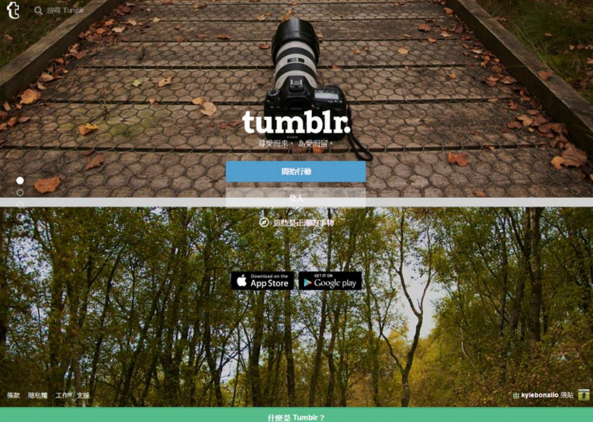
What is Tumblr?

Slide 4
What is Tumblr?

Slide 5
Motivation

Slide 6
Purpose
We want to enable two of the targeted advertising components for Tumblr.
1. Interest Targeting
2. Gender Targeting

Slide 7
Framework

Slide 8
Outline
Introduction
Method
Experiment
Conclusion

Slide 9
Data Preprocessing
Data from Tumblr Firehose
Declared Data
User Profiles
Content feature
Action feature
Notes:
Firehose: 資料串流服務
Twitter firehose新聞:http://www.ithome.com.tw/news/95162

Slide 10
Declared Data
Declared data consists of information provided during sign-up, including keywords from the blog title and blog description extracted using a method.
Method: Removed all HTML tags, followed by the extraction of bigrams and the removal of common English stop-words.

Slide 11
Content feature
Content features were formed from the textual contents of posts which a user either created or reblogged.
EX:
User ui at timestamp t used tag #hp five times and tag #nba eight times.

Slide 12
Action feature
Action features include follows, likes, and reblogs.
EX:
If user ui follows user uj at timestamp t.

Slide 13
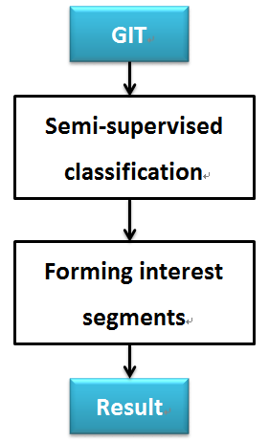
Interest Prediction
General Interest Taxonomy
Notes:
General Interest Taxonomy: https://gemini.yahoo.com/advertiser/home

Slide 14
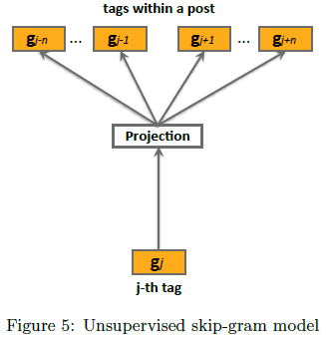
Semi-supervised classification
Proposed semi-supervised classification approach based on the skip-gram model.
Skip-gram model:

Slide 15
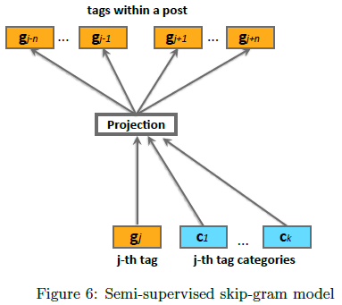
Semi-supervised classification
Semi-supervised skip-gram (SS-SG) model:

Slide 16
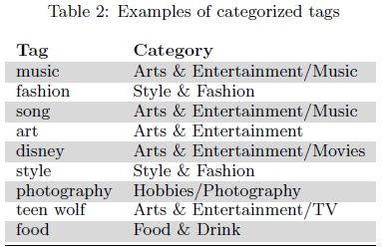
Reinforce for the model
May be expensive in practice as G could easily reach several million tags.
Solution: Negative sampling approach
Our Training like this table:

Slide 17
Forming interest segments
The goal of interest prediction is to identify groups of users with interest in certain topics.

Slide 18
Forming interest segments

Slide 19
Gender Predicition

Slide 20
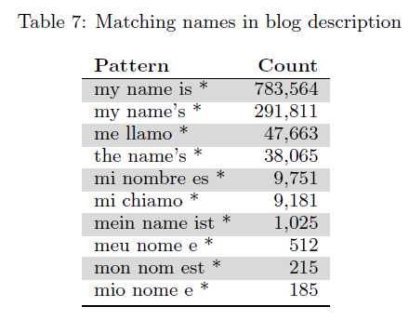
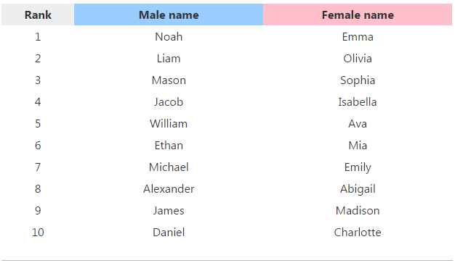
Collecting ground-truth labels
Used US census data of popular baby names from year 1880 to 2013 to create “name gender“ mapping.
Notes:
https://www.ssa.gov/oact/babynames/index.html

Slide 21
Proposed approach
The feature vectors were generated from the user profiles as described in past by setting

Slide 22
Outline
Introduction
Method
Experiment
Conclusion

Slide 23
Result for Interest Prediction

Slide 24
Result for Gender Prediction

Slide 25
Outline
Introduction
Method
Experiment
Conclusion

Slide 26
Conclusion
We presented the steps in the development of a large-scale Tumblr gender and interest targeting framework.
Our gender and interest predictions cover users that generate more than 90% of overall daily activities on Tumblr, and are heavily leveraged by advertisers.

